Slide 1

Modeling Human Behavior with Machine Learning in Built Environments
Final Project Presentation
December 6th, 2022
Poorvesh Dongre, Shrestha Agarwal, Rohit Mehta

Slide 2
Goal
Improve thermal comfort of occupants in building and save building energy
Thermal comfort affects Quality of Living (QoL) including productivity, engagement, emotions in a built environment
The actions occupants take to improve thermal comfort such as interacting with thermostat, windows, etc. has an impact on building energy

Slide 3
Why
Building performance simulation
Facility management
Human-AI Interaction

Slide 4
Focus
Environment
Occupant
1
2
3
n
1
2
3
…
n
…
Discomfort
Behavior

Slide 5
Focus
Discomfort
Behavior

Slide 6
Focus
Environment
Occupant
1
2
3
n
1
2
3
…
n
…
Discomfort
Behavior

Slide 7
Focus
Environment
Occupant
1
2
3
n
1
2
3
…
n
…
Discomfort
Behavior

Slide 8

Focus
Environment
Occupant
1
2
3
n
1
2
3
…
n
…
Discomfort
Behavior

Slide 9
Focus
Environment
Occupant
1
2
3
n
1
2
3
…
n
…
Discomfort
Behavior

Slide 10
Focus
Environment
Occupant
1
2
3
n
1
2
3
…
n
…
Discomfort
Behavior
Thermal Comfort Model
Occupant Behavior
Model

Slide 11
Dataset
Title: Understanding occupants’ behaviour, engagement, emotion, and comfort indoors with heterogeneous sensors and wearables
In-gauge dataset
Indoor & outdoor environmental conditions
Occupancy
Heating & cooling behavior
En-gage dataset
Physiological signals measured with the wristbands
ACC, BVP, EDA, HR, IBI, skin temp
Survey data
Engagement, thermal comfort, seating locations, and emotion data
Gao, Nan, et al. "Understanding occupants’ behaviour, engagement, emotion, and comfort indoors with heterogeneous sensors and wearables." Scientific Data 9.1 (2022): 1-16.

Slide 12

Occupant Behavior Model
}
}
(0)
no action
Cooling behavior data
Logistic Regression
Data
Gathering
PCA
GMM
Sample
Support Vector Machines
(1) cooling on
Heating behavior data
Decision Trees

Slide 13
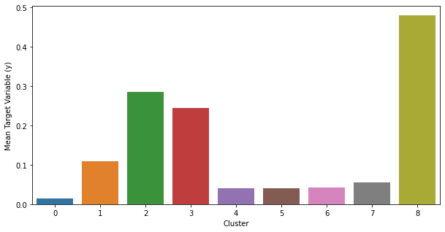
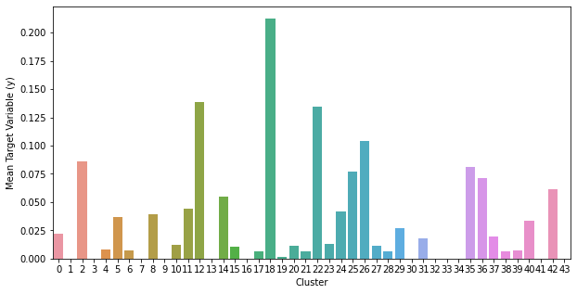
GMM results for balancing the dataset
Cooling Behavior
Lowest AIC = 2254071.45
Component (range 1-10) = 9
Cluster with highest mean value (1) = 8
Heating Behavior
Lowest AIC = 1956759.15
Component (range 1-50) = 44
Cluster with highest mean value (1) = 18

Slide 14
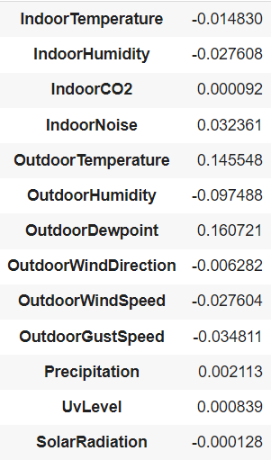
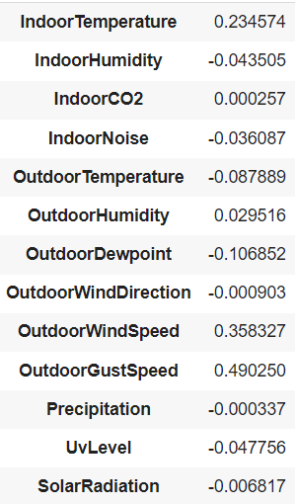
Logistic Regression results for predicting behavior
Cooling Behavior
Test accuracy = 0.9227
Coefficients
Heating Behavior
Test accuracy = 0.8281
Coefficients

Slide 15
Occupant Thermal Comfort Model
Cooler
Engage Dataset
Pipeline for the model –
}
Random Forest Classifier
Feeding the data to various classifiers
No Change
Data
Gathering
Processing Physiological data
K-Neighbors Classifier
From: Survey Data & Raw Physiological Data
Standard Deviation and Mean values
Removing imbalances
Gradient Boosting Classifier
Warmer

Slide 16
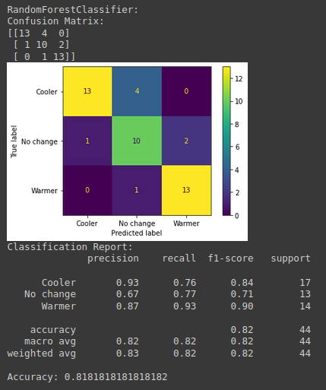
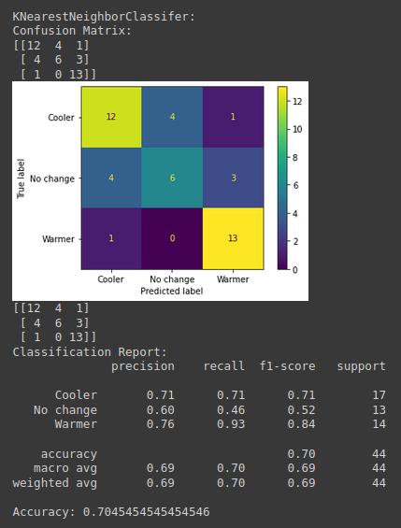
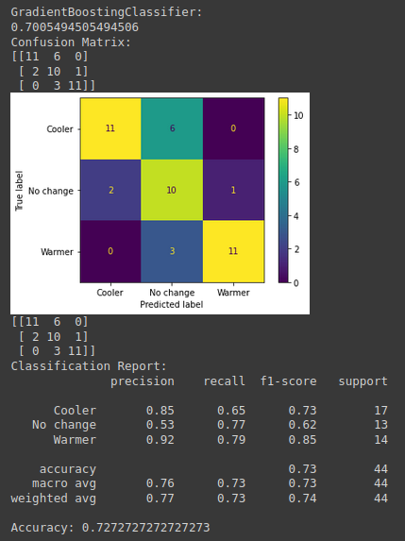
Results for Occupant Thermal Comfort Models

Slide 17
Environment
Occupant
Self-
Reported
1
2
3
n
1
2
3
…
n
…
Discomfort
Behavior
Thermal Comfort Model
Occupant Behavior
Model

Slide 18
Environment
Occupant
Self-
Reported
1
2
3
n
1
2
3
…
n
Physiological sensors
…
Discomfort
Behavior
Thermal Comfort Model
Occupant Behavior
Model

Slide 19
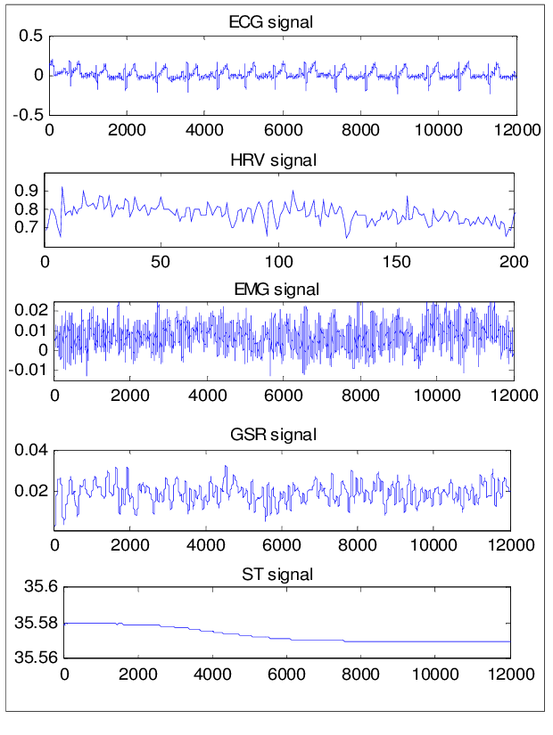
Physiology for thermal preference prediction
Thermal
Preference
1
Flatten
Dense
RELU
Drop
out
Flatten
Dense
RELU
Drop
out
Flatten
Dense
RELU
Drop
out
Dense
Soft
max
2
3
En-gage dataset
Multi Layer Perceptron

Slide 20
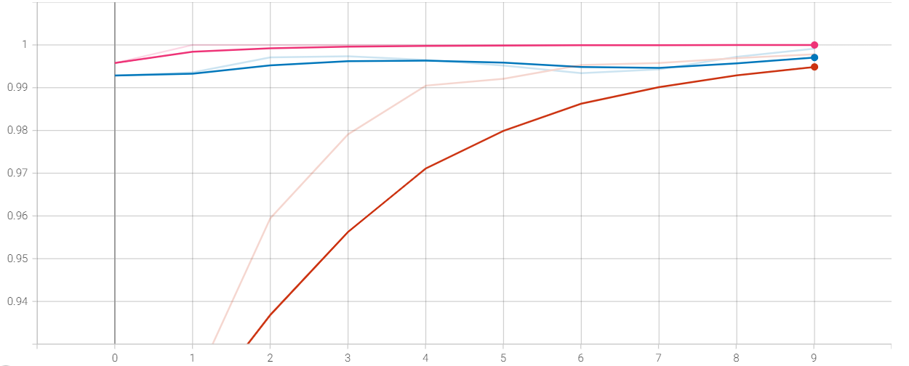
Epoch Accuracy for Different Optimizers
Adam
RMSprop
SGD
Notes:
SGD - Stochastic Gradient Descent
Noisier than typical Gradient Descent as it takes higher number of iterations to reach the minima because of its randomness in its descent.
Much less expensive than typical Gradient Descent.
Challenges in SGD - to choose a proper learning rate.

Slide 21
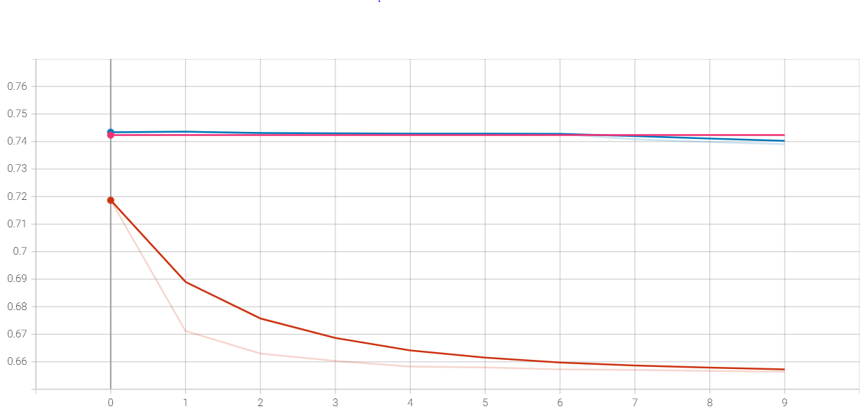
Epoch Loss for Different Optimizers
RMSprop
Adam
SGD

Slide 22
Future Scope
Implementing more models for behavior and comfort prediction
Check the causality between the thermal comfort model and behavior model
Using transfer learning on physiological data for identifying other states such as emotions

Slide 23
Thank You!

